Slide 1
“NPS is the place to create a complete thought,
away from the tyranny of the urgent.”
—Col Todd Lyons, USMC, July 2019
Foundations of Academic Writing
JANUARY 2025

Slide 2
Housekeeping
Webinar Q&A
Slides online now, video later
Attendance credit
5-minute break
Foundations of Academic Writing
JANUARY 2025

Slide 3
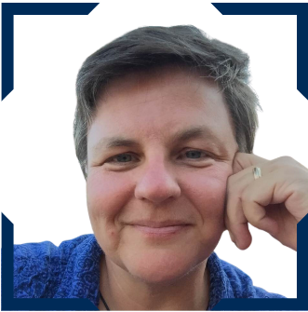
Intro to Grad School Research and Writing
George Lober, ctr Graduate Writing Center
Writing Coach
Plagiarism Prevention
Aileen Houston Graduate Writing Center Deputy Director
The Writing Process
Dr. Kate Egerton, ctr Graduate Writing Center Senior Writing Coach
Using Human Subjects Data
Bryan Hudgens Institutional Review Board
Chair
online
Foundations of Academic Writing
JANUARY 2025

Slide 4
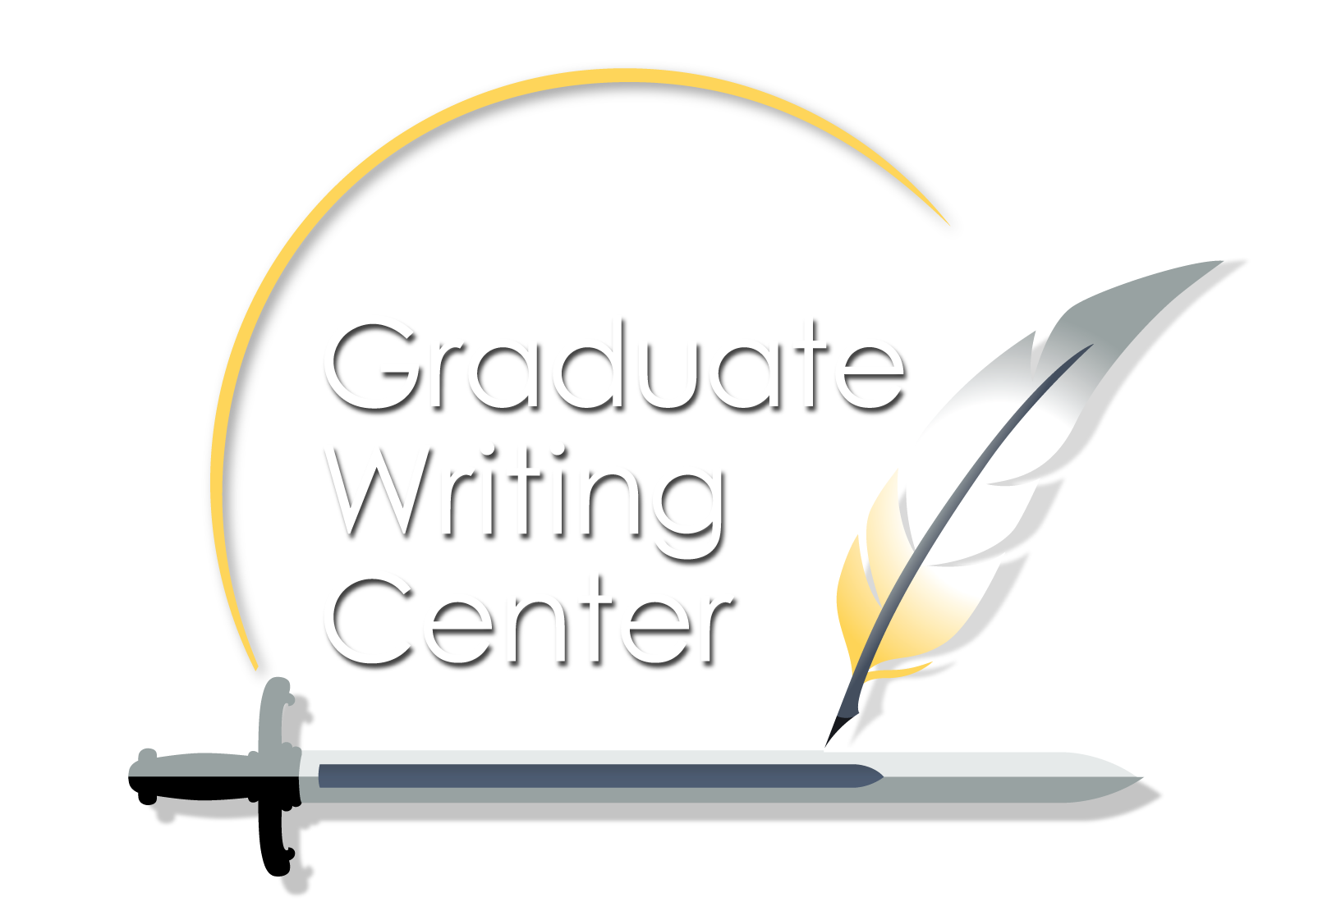
Introduction to Grad School
Research and Writing
George Lober
Senior Writing Coach, Graduate Writing Center (contractor)
Emeritus Faculty, NPS
Foundations of Academic Writing
January 2025

Slide 5
Introduction to Grad School
Research and Writing
“’Nuf said!”
Foundations of Academic Writing
January 2025

Slide 6
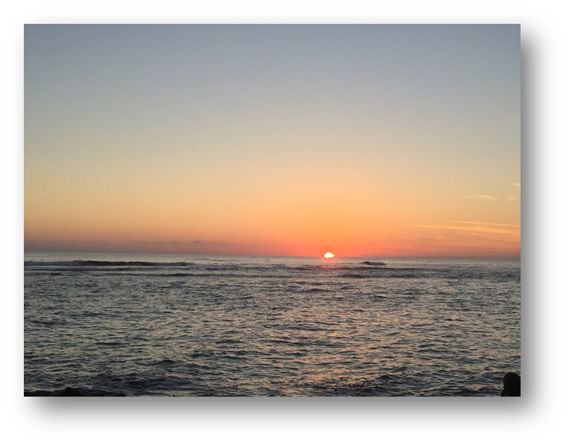
Graduate Writing Center
nps.edu/gwc
Introduction to Grad School Research and Writing
Develop your ideas

Slide 7
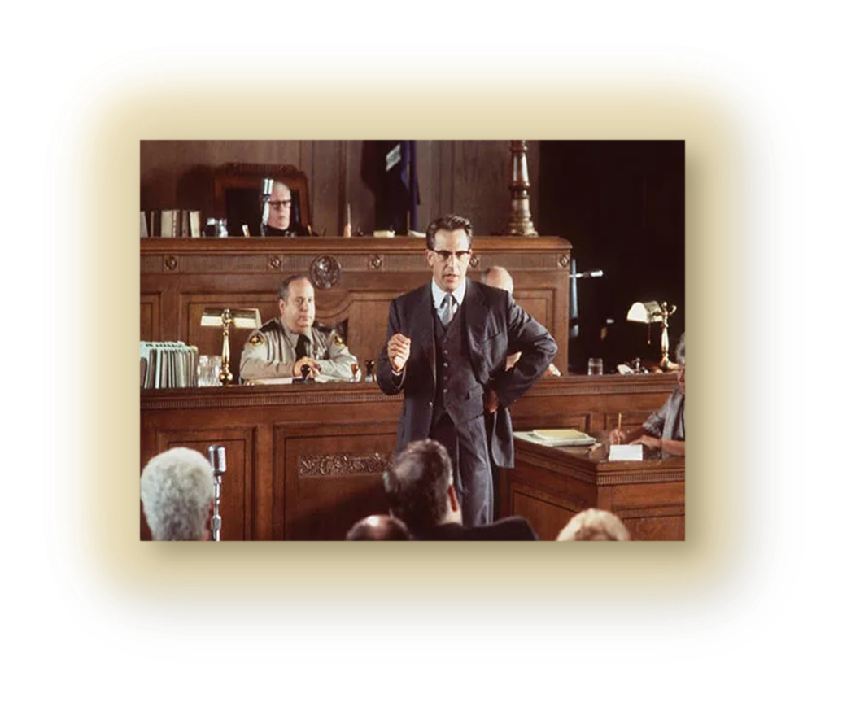
Graduate Writing Center
nps.edu/gwc
Introduction to Grad School Research and Writing
Develop your ideas
BLUF
Thesis
Roadmap

Slide 8
Graduate Writing Center
nps.edu/gwc
Introduction to Grad School Research and Writing
Because you are a student, it is automatically assumed that you have not:
Read enough
Been published enough
Recognized enough to stand on your own opinion
You have to do research
The American academy

Slide 9
Graduate Writing Center
nps.edu/gwc
Introduction to Grad School Research and Writing
You can’t stand upon your own opinion. You must:
support!
support!
support!
your work
You have to do research
The American academy
The bottom line

Slide 10
Graduate Writing Center
nps.edu/gwc
Introduction to Grad School Research and Writing
Your instructors will tell you
Assigned class readings
Ask for recommendations
DKL librarians
Not all research is high-quality.
How do you differentiate?

Slide 11
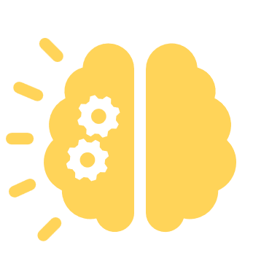
Graduate Writing Center
nps.edu/gwc
Introduction to Grad School Research and Writing
You have to do some responsible critical thinking
Wikipedia – Not so much
Newspaper – Depends
Data and statistics – Maybe
Blogs, podcasts – sketchy
Online posts – sketchy
AI – double-edged

Slide 12
Graduate Writing Center
nps.edu/gwc
Introduction to Grad School Research and Writing
Look for unbiased, thorough, responsible analysis, discussion, and reporting.
When you find such sources, cite them if you use them to support your ideas.
Academic journals
Peer-reviewed journals
Books
Reports

Slide 13
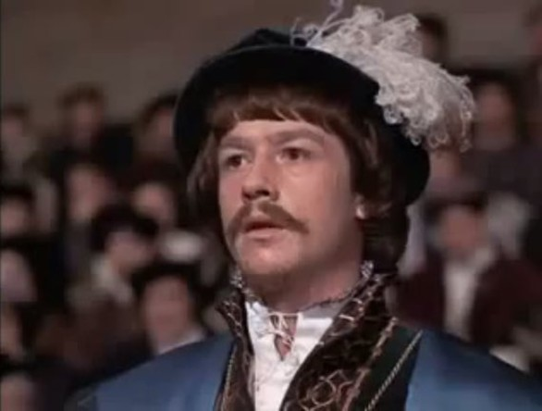
Graduate Writing Center
nps.edu/gwc
Introduction to Grad School Research and Writing
Two words about AI:
Fluid
Integrity

Slide 14
Foundations of Academic Writing
January 2025
Plagiarism Prevention
Using Sources in Your Writing
Aileen Houston | Deputy Director, Graduate Writing Center

Slide 15
Plagiarism Prevention
The Blindside
NPS alum accused of plagiarism in thesis
Alum in a news interview:
“I've got 362 citations in my 112-page thesis. . . . I did everything that I could to avoid that."
Qtd. in PolitiFact

Slide 16
The Accusation:
Source (ACLU)
“. . . lifts language from sources and credits them with a footnote, but does not indicate with quotation marks that he is taking the words verbatim.”
NPS thesis
Adapted from CNN

Slide 17
". . . technically you're supposed to put quotation marks around that. I didn't do that. It's a technical . . . error."
Image source: Etsy
Qtd. in PolitiFact
NPS Honor Code
“Unintentional plagiarism, or sloppy scholarship, is academically unacceptable.”

Slide 18
Plagiarism Prevention
What you don’t know
can hurt you

Slide 19
Plagiarism Prevention
1
What to attribute
What you need to know
2
How to cite
3
How to quote and paraphrase
4
How to be in control of your authorship

Slide 20
Plagiarism Prevention
Yes, cite!
Ideas
you didn’t come up with
Data, graphics
you didn’t create
Words
you didn’t write
What to attribute
No, don’t cite.
Your findings
and ideas
Attribution =
crediting what you borrowed
Common language
Common knowledge

Slide 21
Citations
Signal Phrases
How to cite
Differ by style
Signal to reference list
Signal source w/out citation
Use for continued discussion
Show that information comes from a source by using:
In [13] and [14]
Their research illustrates...
Lim’s 1999 study revealed...
Lim also examined...
Citations
(Li & Sanchez, 2019)
As the article suggests...
Signal phrases
Recent reports disagree.⁸⁷
According to the website...
Sentence flow
Sentence flow
Your goal:
distinguish between
source evidence and
your own input
DiRenzo and Aten (2015) conducted a mixed-method study. Phase I included semi-structured interviews. Phase II consisted of a survey of Reserve Marines. The survey addressed the themes of relationships, opportunities, and role conflict, while assessing the influence of financial incentives in re-affiliation.
Adapted from McCombs and Heffernan

Slide 22
Citations and signal phrases
The NPS thesis

Slide 23
iThenticate report
The same thesis

Slide 24
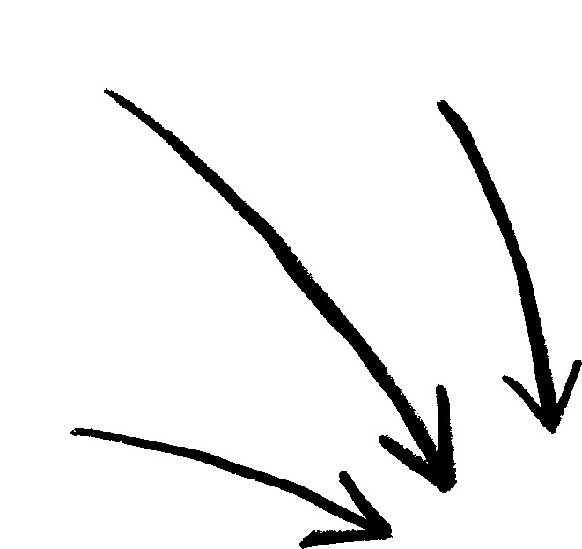
Put borrowed (copied) phrases or sentences between “quotation marks” to show you didn’t write them.
Direct quotations
Arpprox. 5+ words
Can be said differently
Citation = credit for idea
Quotes = for words
Need to change, add, or skip phrasing? Use [brackets] to show changes and an
ellipsis . . . to signal deletions.
Adapted from McCombs and Heffernan

Slide 25
Direct quotations
How would you revise?

Slide 26
From the source
Paraphrased
Paraphrasing
IEEE and its organizational units engage in coordinated public policy activities at the national, regional, and international levels in order to advance the mission and vision of securing the benefits of technology for the advancement of society.
To achieve its mission of advancing society through technology, IEEE develops public policy recommendations for both national and global policymakers (IEEE, n.d.).
Using your own words and sentence structure to describe information from a source
1
Summarize: lengthy / detailed
IEEE. n.d. “About.” Accessed June 27, 2024. https://www.ieee.org/about/index.html.
2
Paraphrase: specific idea / passage
Why paraphrase?
Always CITE summarized and paraphrased
info!
The original is overly complex
The source is hard to understand
The passage doesn’t
match your style

Slide 27
Patchwriting
1
2
Patchwriting:
“small changes and substitutions to copied source material”
Paraphrasing: your own words and sentence structure to describe source material
Source: Merriam Webster

Slide 28
Plagiarism Prevention
Pop quiz
How would you revise this paragraph?
Things to consider:
1
What needs to be cited
2
Quoting and paraphrasing rules
3
Common knowledge and language

Slide 29
Plagiarism Prevention
1
Know the rules of the road for AI
Ask your professor.
Understand the official guidance
Know when to cite or disclose
Be in control
of your authorship
2
Know how to retain control of your work
Readers assume your writing is your writing unless you tell them otherwise.
Don’t let the tool think, create, or write
for you.
Explore and experiment with good uses
Review AI output carefully for accuracy and changes

Slide 30
Foundations of Academic Writing
January 2025
Learn more online
nps.edu/gwc
writingcenter@nps.edu

Slide 31
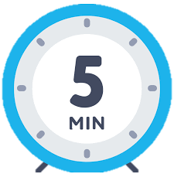
Foundations of Academic Writing
JANUARY 2025

Slide 32
The Writing Process
Kate Egerton, PhD (contractor)
January 10, 2025
Graduate Writing Center
Naval Postgraduate School
Notes:
Hi.

Slide 33
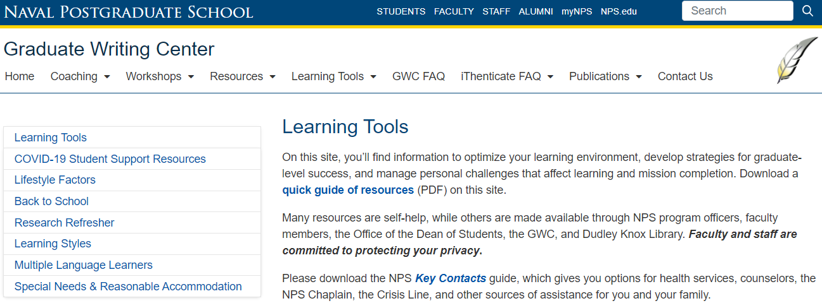
Learning Tools
Each learner is different
You are probably not the same student you were before
Notes:
First, let me point to a handout in your packet. Learning Tools is an initiative of the GWC and others on campus to help you optimize your learning environment. Think about who are you now, versus the last time you were a student:
New discipline?
New experiences?
New life, responsibilities?
New medical issues that might affect your learning?
We want you to succeed, and we want you to be aware of the resources, including the possibility of accommodations.
This handout guides you through the Learning Tools section of the GWC website, and gives you an overview of the tools available there.

Slide 34
Expert writers:
Embrace the writing process
Practice writing early and often
Write to learn before writing to explain
Notes:
Here’s what I’m going to cover today on the writing process:
The writing process, and how it will help you succeed,
The virtues of practicing this process, especially when you’ve not been a full-time graduate student writer recently,
How writing to learn is different from writing to explain.

Slide 35
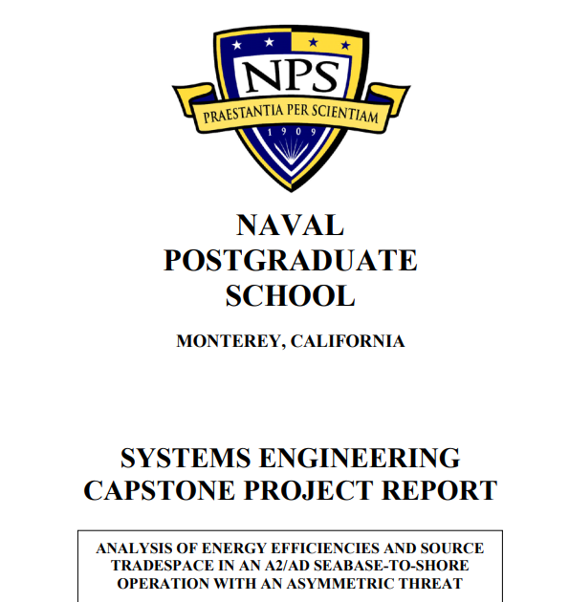
Notes:
Here at NPS, the most significant writing most students produce is the thesis, or capstone, and the time to start building skills for that project is . . . right now.

Slide 36
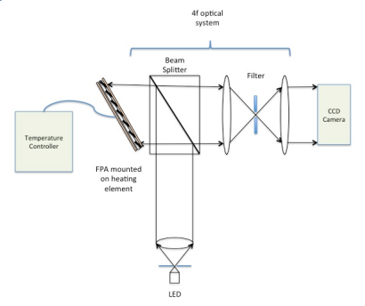
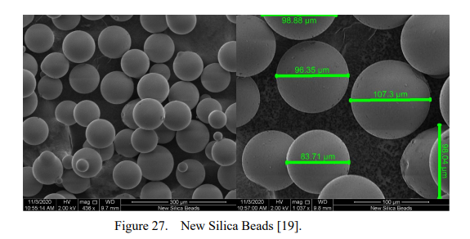
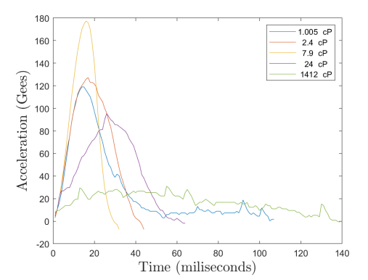
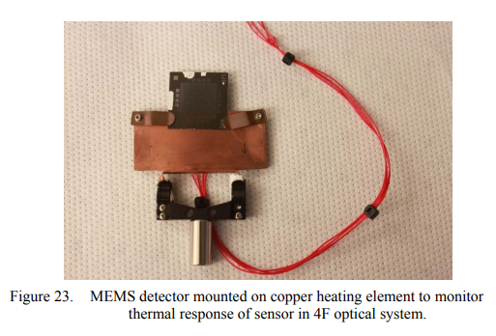
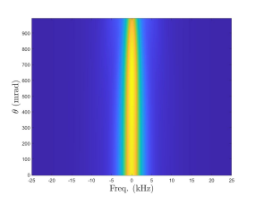
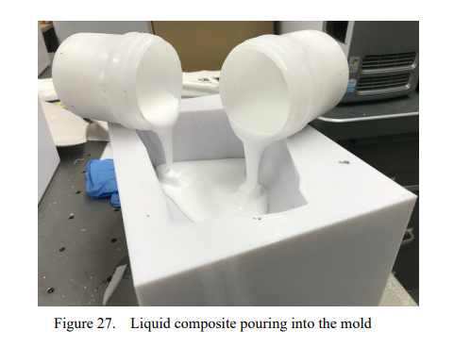
Notes:
Here at NPS, the most significant writing most students produce is the thesis, or capstone, and the time to start building skills for that project is . . . right now.

Slide 37
I would use numbers on this first slide. Then you can go without. But it helps ground them. Heck, they’re used to numbering paragraphs. It’s in their comfort zone.
1. Invent
Writing to learn
2. Draft
3. Revise
Writing to explain
4. Edit
5. Finalize
Ready to deliver
Notes:
So let’s dig into the Writing Process.
If you aren’t accustomed to thinking of yourself as a writer, it’s easy to buy into the popular illusion that expert writers don’t use any steps at all. How lovely to think that the words of whatever you’re reading just spilled out in that exact order, overflowing from someone’s brain with no effort whatsoever.
On the contrary, expert writers understand the import of each step.
That comes with practice.

Slide 38
Start before you are really ready
Stop before you are really done
Repeat —Robert Boice
Notes:
That’s what makes this one piece of advice from Robert Boice (psychologist, procrastination researcher, and mentor to new academics like yourselves) so useful.
Write before you are ready, and at any given work session, stop before you think you are done. Then repeat. Build writing time into your daily schedule. 10 minutes is a LOT better than nothing. 5 minutes is, too.
The “stop before you think you are done” part is like not exercising to exhaustion every time you go out for a morning jog. Set yourself an appointment (and a reasonable goal), work for that time, and then stop while you still have some momentum (or just because your clock has run out).
Consider spending the last minute of a writing session making yourself some notes about what you would do next, IF you were going to keep working. These should be small, concrete steps, so that when you return to work, you’ve given yourself discrete tasks to do first.

Slide 39
Invent
Writing to learn
Draft
Revise
Writing to explain
Edit
Finalize
Ready to deliver
Notes:
Invention, also known as pre-writing, is almost anything that allows you to think on paper, and usually in a form that’s distinct from how the finished product will look. Journaling is good. Scribbling on the backs of envelopes works. If you like early outlines, do those, too.
The key is that pre-writing must be low-stakes and done early enough that you’re not staggering under an imminent deadline.
It can also be done in short increments, often 5-10 minutes at a time.

Slide 40
Generative AI at NPS
Build your AI Literacy with Dudley Knox Library’s Generative AI Research Guide
Consult Generative AI Guidance for all citation styles at Dudley Knox Library
Follow the Official Guidance from the Provost’s Office
Notes:
Invention, also known as pre-writing, is almost anything that allows you to think on paper, and usually in a form that’s distinct from how the finished product will look. Journaling is good. Scribbling on the backs of envelopes works. If you like early outlines, do those, too.
The key is that pre-writing must be low-stakes and done early enough that you’re not staggering under an imminent deadline.
It can also be done in short increments, often 5-10 minutes at a time.

Slide 41
Invent
Draft
Writing to learn
Revise
Writing to explain
Edit
Finalize
Ready to deliver
Notes:
Drafting flows from pre-writing once you’ve figured out the question that needs answering today. Your THESIS STATEMENT is, in a compact form, the ANSWER to that question. Faculty will sometimes provide you with a question, but often they won’t—you have to come up with it yourself.
The main point of drafting, like pre-writing, is to generate text and to get the words from the inside of your head onto a page. Any page. If that means speech-to-text software, or legal pads, or a close, personal relationship with your laptop, that’s all great.
Here’s a cardinal rule, though—keep moving forward. Minimize deleting, resist the temptation to review right now, and for the love of god don’t edit so long as the task at hand is drafting.

Slide 42
Perfectionism is the voice of the oppressor, the enemy of the people. It will keep you cramped and insane your whole life, and it is the main obstacle between you and a shitty first draft.
−Anne Lamott
Notes:
Early drafts are, and should be, kinda ugly.
Shitty, even.
Do not—DO NOT—let the perfect be the enemy of the good.

Slide 43
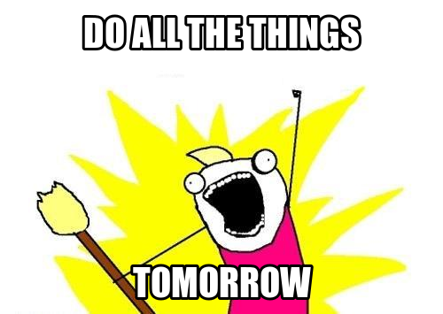
Adapted from: Allie Brosh, http://hyperboleandahalf.blogspot.com/2010/06/this-is-why-ill-never-be-adult.html
Notes:
Most of us, me included, are pretty great at waiting to draft, at deciding that I can’t possibly start writing right now because of any number of excellent reasons, headlined by
“I’m just not in the mood.”

Slide 44
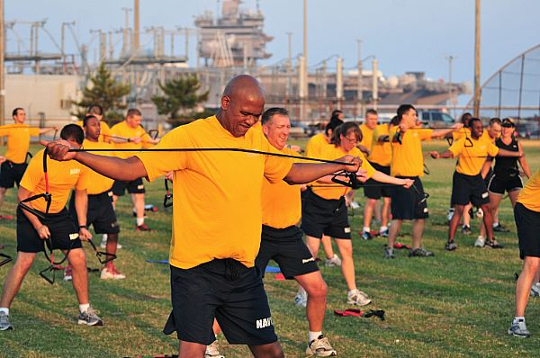
100623-N-1688B-064 NORFOLK (June 23, 2010) Command Master Chief Keith Mahaffey, assigned to the guided-missile cruiser USS Monterey (CG 61), participates in the commissioning of the Navy Operational Fitness and Fueling System (NOFFS). NOFFS is the Navy's new physical fitness program that is designed to give an all around workout while reducing physical training injuries. (U.S. Navy photo by Mass Communication Specialist 2nd Class Matthew Bookwalter/Released)
Notes:
That that excuse doesn’t work any better in the library than it does in the gym.
You don’t put off training for a marathon, or even for your next physical fitness test, and you shouldn’t put writing off, either.
Build your writing habits like you plan your physical training—I’m not in the mood to go to hot yoga class. I went yesterday. I’ll go tomorrow. Tough cookies, self—go anyway. Now.

Slide 45
Invent
Draft
Writing to learn
Revise
Writing to explain
Edit
Finalize
Ready to deliver
Notes:
Where are we? Woah—still drafting. That’s ok!
Here’s a cardinal rule, though—keep moving forward. Minimize deleting, resist the temptation to review right now, and for the love of god don’t edit so long as the task at hand is drafting.
When you edit early, you fix sentences that aren’t going to serve your final product, and having fixed them, you get attached, like bonding with a stray puppy when your kid is horribly allergic to dogs. Then you cling to the pup even when you know you shouldn’t, and you can see where this is going.
Microsoft Word, aggravatingly, seems to encourage editing early, and by early, I mean every damn second.
Attending immediately to each squiggly line is also a terrific way to never get to the next sentence at all. If, back when you were a kid, you were traumatized by red-pen wielding maniacs, this can really be a problem.

Slide 46
When you draft, try starting somewhere in the middle
Choose something you already understand that your reader needs to know
Cite as you go, keeping track of which words, ideas, and data belong to whom
If you get stuck, skip to another subtopic within your project and start another paragraph
Notes:
So what SHOULD you do while drafting (if not edit)?
This stuff (on list)

Slide 47
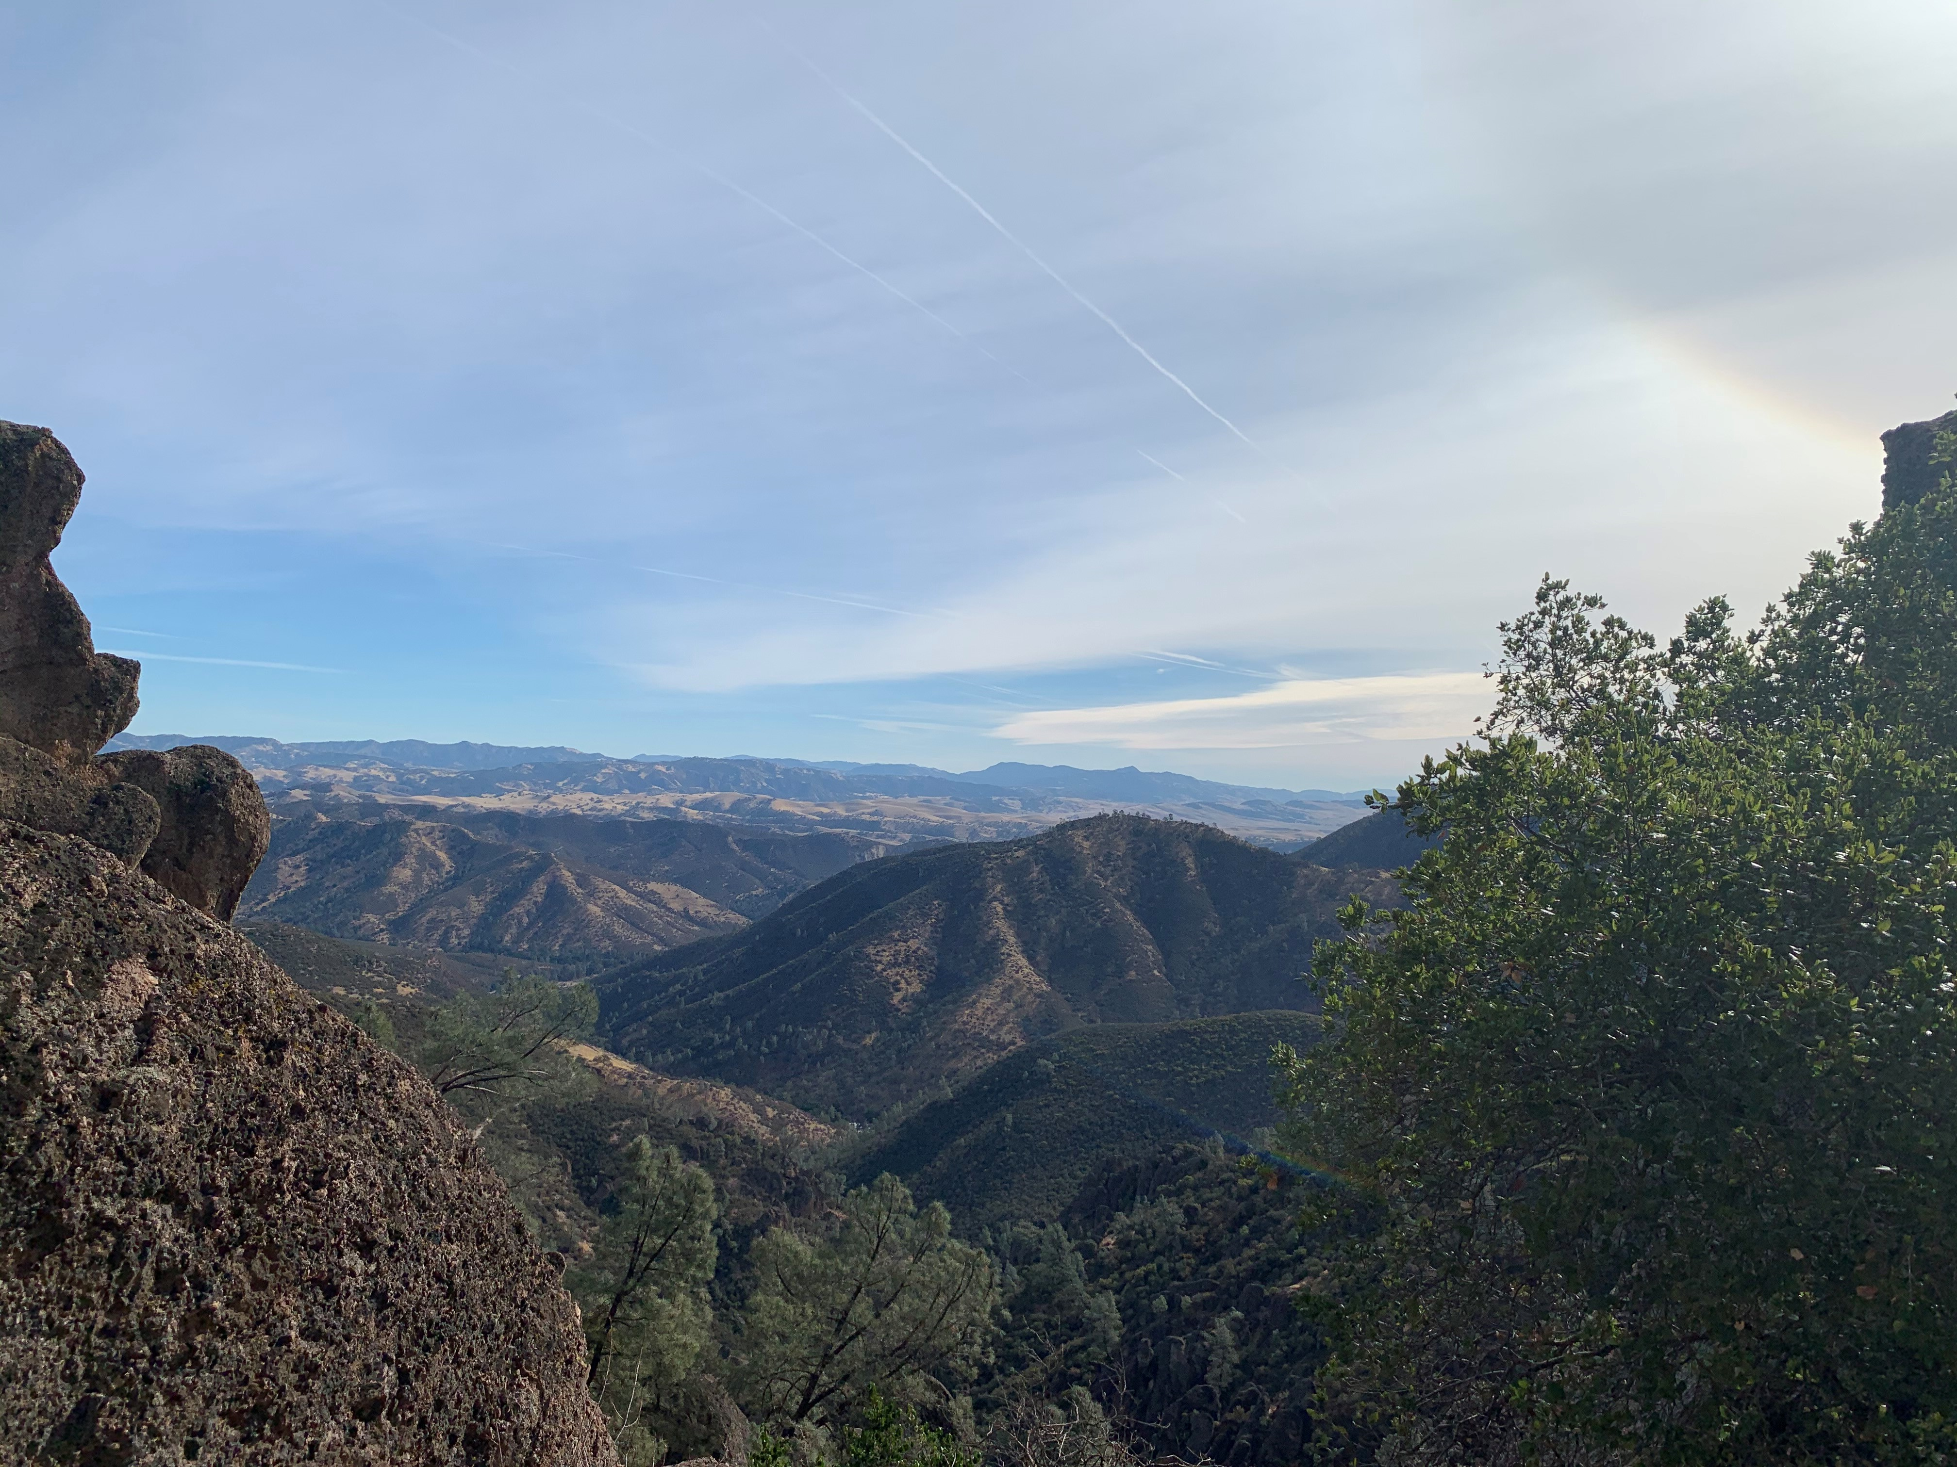
Notes:
Go hiking at Pinnacles National Park, just across the Salinas Valley.
Failing that, hang out with your family, change the oil in your car, go for a run, do a problem set, or get some sleep. When you come back, your draft will still be there.
I promise.

Slide 48
Invent
Writing to learn
Draft
Revise
Writing to explain
Edit
Finalize
Ready to deliver
Notes:
OK, NOW it’s time to revise.
Revise as a word, implies “re-seeing,” and more specifically, “re-examining,” which is why you need fresh eyes to do it well. This is the time to ask questions like “so my point here really is?” and to reassess both the evidence you’ve gathered and the analysis you’ve created in the service of your specific argument.
Here are some useful steps: (next)

Slide 49
Highlight (or write, if it’s missing) each paragraph’s topic sentence
Quickly outline your draft and audition changes
Fill gaps and kill repetition
Revise your thesis and place it front and center—what have you proven?
Now write (or revise) the introduction that sets up that thesis and a “so what, here’s why” conclusion
Notes:
In NPS course papers, as in many professional writing situations, you will be implored—over and over again—to put your Bottom Line Up Front (BLUF). That means the thesis goes on page one.
Remember, writing in graduate school is the big tool you use to solve a problem when lesser tools won’t work, and if you already knew the answer to your question before you struck the first key, you might be shooting squirrels with a grenade launcher.
I promise that the thesis statement you write during revision will be better than the one you took a shot at earlier. And before you take a crack at revising the thesis currently sitting in your introduction, read the last page of the paper and look to see if, just perhaps, there’s a GREAT thesis statement hanging out on the last page. Quite often, there is, ripe for the plucking.

Slide 50
Invent
Writing to learn
Draft
Revise
Edit
Writing to explain
Finalize
Ready to deliver
Notes:
Ok, so now you have revised. You have a strong thesis, stated clearly up front where your BLUF-seeking reader wants it to be, and a well-organized set of paragraphs that lay out your evidence and analysis.
When you’re confident in your content—your argument, your evidence, your analysis—and ONLY then, should you start fiddling with sentences and editing your prose. If you edit too early, remember, terrible things happen.

Slide 51
Take time away from your text
Create distance between your text and your brain by reading sentences out loud and, perhaps, out of order
Can you find the subject and verb of every sentence? And do they agree?
Are you punctuating consistently?
Did you spell everyone’s name correctly each time?
NOW use spell & grammar check
Notes:
Go through list.

Slide 52
Invent
Writing to learn
Draft
Revise
Writing to explain
Edit
Finalize
Ready to deliver
Notes:
So here we are. You have invented. Drafted. Revised. Edited.
What’s left? Just a few things.

Slide 53
Find and follow your format
Check name spellings ONE MORE TIME
Perfect citations and references according to your chosen style (don’t mix and match)
Deliver through the proper channels
Keep archive copies of all work
Notes:
Go through list.
The Graduate Writing Center, Dudley Knox Library and the Thesis Processing Office have great tools to help you cite correctly, no matter which style you are using, and there’s a handout on that topic in your packet, too. We are all here to help you succeed at NPS; come and see us!

Slide 54
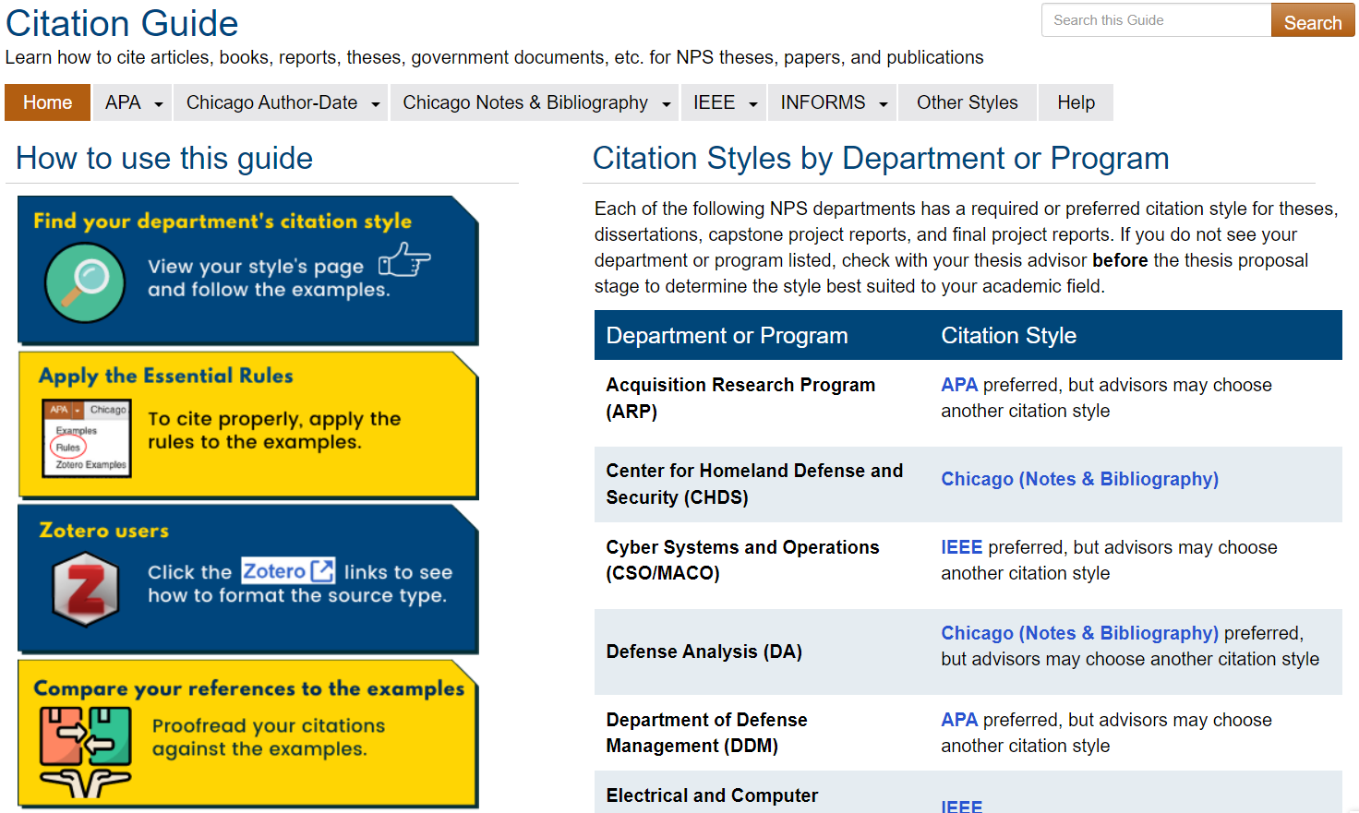
Dudley Knox Library’s Citation Guide

Slide 55
The GWC is here for you
Use our workshops, coaching sessions, and online resources
Build writing habits now that will support you through your thesis and beyond
Notes:
Go through list.
Bye!

Slide 56
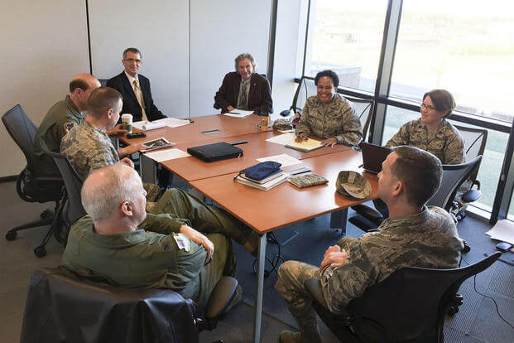
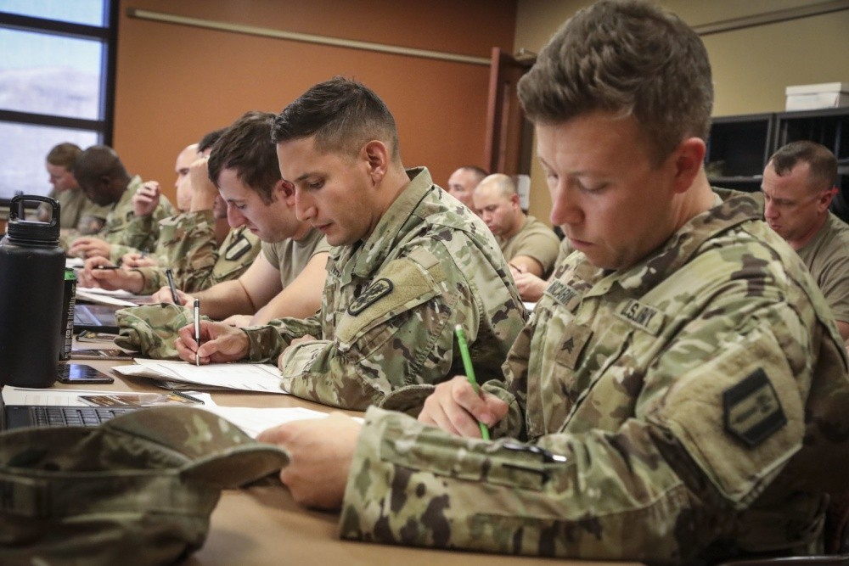
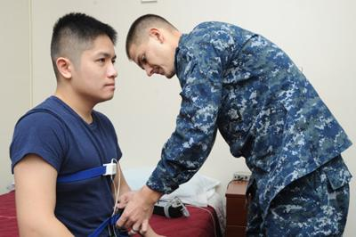
Going Straight to the Source: Using Human Subjects Data in Your Thesis, Capstone Report, or Dissertation
Bryan Hudgens
Chair, Institutional Review Board
January 2025

Slide 57
Click to view online

Slide 58
TL;DO (Too Long; Dozed Off)
You can do lots of really cool thesis projects!
If you get data from or about living humans for your research…
…they might need protection from any harm your study might cause, so…
…you must (by Federal regulation) check with the Institutional Review Board (IRB) before you begin your research.
Under DOD and DON Instructions, only formally-appointed people (*) can tell you if your study is (or is not) “research involving human subjects (HSR).”
Your advisors (**) are NOT one of these people.
You’re the hero, we’re (some of) your guides. Let us help you!
(*) Currently, NPS has appointed 3 people: IRB Chair and two IRB Vice Chairs.
(**) Your advisors are super smart. As a rule, listen to them! But they’re not authorized to make this call.

Slide 59
HRPP and IRB Contact Information
NPS IRB website and email:
https://my.nps.edu/web/research/irb IRB@nps.edu
IRB Contact Information:
IRB Chair: Bryan Hudgens
bryan.hudgens@nps.edu
HRPP Support: Ali Shapard (Lead Specialist)
alicia.shapard@nps.edu
Scott Ramos (Specialist) Cynthia Burns (Specialist)
sramos@nps.edu cynthia.burns@nps.edu

Slide 60
Live Coaching
1:1, in real time
Async Coaching
emailed feedback
Write-ins
structured studying
Learn Online
writing resources
The Graduate Writing Center
https://nps.edu/gwc

Slide 61
nps.edu/gwc
Research skills
Zotero citation manager
Thesis preparation
Academic norms
Critical thinking
Writing mechanics
Workshops – sign up online!
https://nps.edu/gwc/live-workshops

Slide 62
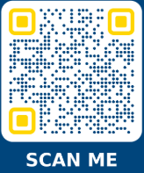
Please fill out our survey
Foundations of Academic Writing
THANK YOU

