Slide 1
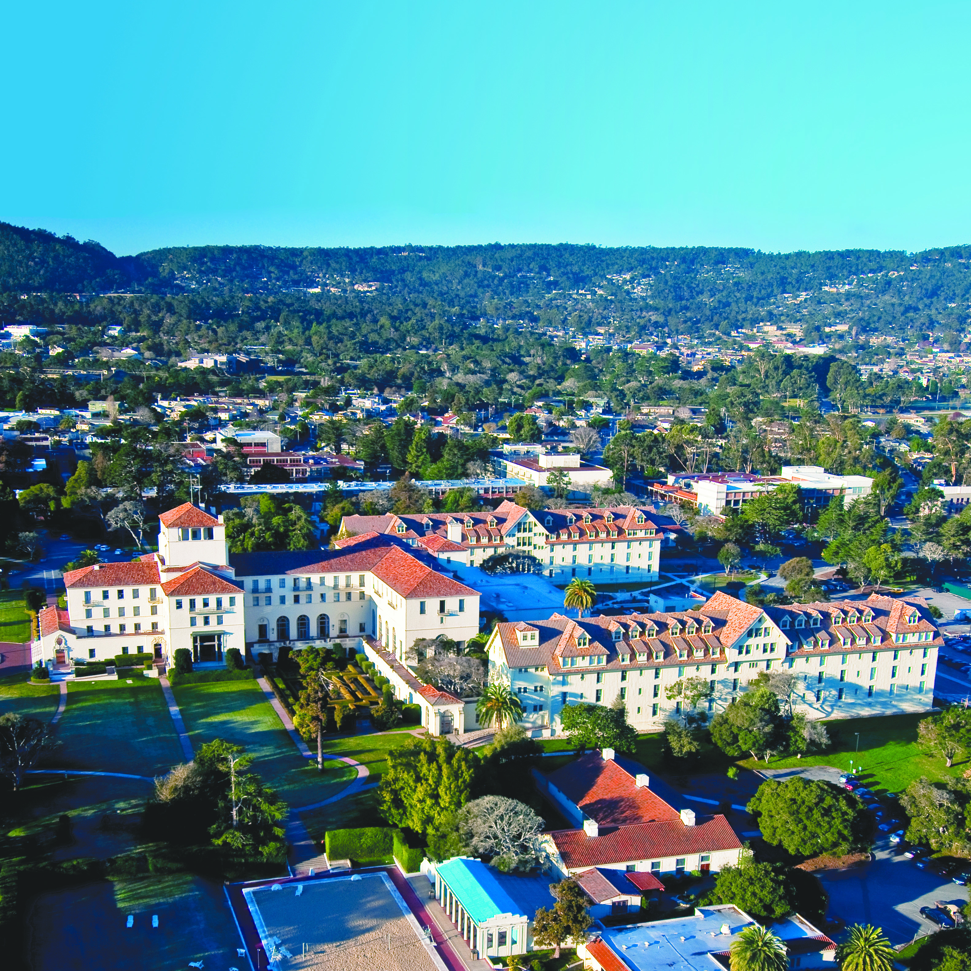
NAVAL POSTGRADUATE SCHOOL
1 University Circle, Monterey, CA
www.nps.edu

Slide 2
Distance Learning (DL) Programs

Slide 3
Summary of Academic Programs
Certificates (DL)
Space Systems Certificate (273)
Space Nuclear Command, Control & Communications (NC3) Certificate (298)
Space Systems Design Certificate (253)
Masters of Science (MS) Degrees (in residence)
MS, Space Systems Engineering (591)
MS, Space Systems Operations (366)
Masters of Engineering (ME) Degrees (DL)
In work

Slide 4
Space Systems Certificate (273)
Taught in residence and via DL (asynchronously)
Two starts (Fall and Spring)
Total of 4 courses from the following matrix
Course Number | Title | Lecture Hours | Lab Hours
SS3011 | Space Technology and Applications | 3 | 0
SS3613 | Military Satellite Communications | 3 | 0
OR
SS3610 | Space Communications Systems: Fundamentals and Analysis | 4 | 2
PH3052 | Physics of Space and Airborne Sensor Systems | 4 | 0
PH2514 | Introduction to the Space Environment | 4 | 0
OR
SS3051 | Military Applications of DoD and Commercial Space Systems | 4 | 0

Slide 5
Space Nuclear Command, Control & Communications (NC3) Certificate (298)
Taught via DL (asynchronously)
Two starts (Winter and Summer)
January entry date starts with SS3011
July entry date starts with SS3740
Course Number | Title | Lecture Hours | Lab Hours
SS3011 | Space Technology and Applications | 3 | 0
SS3613 | Military Satellite Communications | 3 | 0
SS3740 | Nuclear Command, Control, and Communications Systems - Part I | 3 | 0
SS3741 | Nuclear Command, Control, and Communications Systems - Part II | 3 | 0

Slide 6
Space Systems Design Certificate (253)
Taught via DL (asynchronously)
One start (Fall)
Currently supports DoD Space educational needs and is targeted primarily at providing DoD Space employees with top-level knowledge in spacecraft design
Course Number | Title | Lecture Hours | Lab Hours
SS3011 | Space Technology and Applications | 3 | 0
AE4830 | Spacecraft Systems I | 4 | 1
AE4831 | Spacecraft Systems II | 3 | 2
SS3051 | Military Applications of DoD and Commercial Space Systems | 4 | 0

Slide 7
MS, Space Systems Engineering (591)
Multiple starts, in residence
Navy officer students complete a 27-month program, including P-code and JPME requirements
A refresher quarter is available as needed
Multiple disciplinary tracks are offered
Astronautical Engineering
Electrical Engineering
Physics
Computer Science
ABET accredited degrees
Contact NPS Program Officer for details

Slide 8
MS, Space Systems Engineering (591)
One-year option is currently available for DoD and DoD contractor civilians and USNA academic scholars
Sample matrix shown below
Quarter (# / Time of Year) | Course 1 | Course 2 | Course 3 | Course 4 | Course 5
1S | AE3851 (3-2) Spacecraft Propulsion | EC3320 (3-2) Optimal Control | SS3051 (4-0) Mil. DoD & Comm Space Systems (S) | EC2440(3-2)* Intro to Scientific Prog* | SS4000 (0-1) Seminar
2F | SS3861 (2-4) Spacecraft Payload Design I | AE3804(3-2) Spacecraft Thermal Control | AE4850 (3-2) Astrodynamic Optimization | AE0810 (0-8) Thesis Research | SS4000 (0-1) Seminar
3W | SS3500(4-2) Orbital Mechanics & Launch Systems | AE3818 (3-2) Spacecraft Attitude Determination & Control | AE4881(2-4) Aerospace Trajectory Planning & Guidance | AE0810 (0-8) Thesis Research | SS4000 (0-1) Seminar
4S | AE4870 (4-0) Spacecraft Design & Integration I | AE4820(3-2) Robotic Multibody Systems | AE0810 (0-8) Thesis Research | AE0810 (0-8) Thesis Research | SS4000 (0-1) Seminar

Slide 9
MS, Space Systems Operations (366)
One start (Fall), in residence
Navy officer students complete a 21-month program, including P-code and JPME requirements
A refresher quarter is available as needed
Contact NPS Program Officer for details

Slide 10
MS, Space Systems Operations (366)
1-year option is offered to students who do not need a Navy subspecialty code, i.e., USAF U2 personnel
Sample matrix shown below
Quarter (# / Time of Year) | Course 1 | Course 2 | Course 3 | Course 4 | Course 5
1F | PH2514 (4-0) Space Environment | EC1010 Introduction to MATLAB | PH3052 (4-0) Remote Sensing | SS3011(3-0) Space Technologies & Applications
2W | NS4677 (4-0) Space & International Security | SS3610 (4-2) Space Communications Systems | SS3400 (4-2) Orbital Mechanics, Launch and Space Operations | SS0810 Thesis
3S | SS3041(4-2) Space Systems & Ops 1 | SS3613 (3-0) MILSATCOM Systems | AE4830 (4-1) S/C Systems I | SS3600 (2-3) Modeling & Simulation | SS0810 Thesis
4S | SS3051 (4-0) Military Applications of DoD & Commercial Space Systems | SS3001 (3-2) Military Applications of Space | AE4831(3-2) S/C Systems 2 | Elective 4000 | SS0810 Thesis

Slide 11
ME Degree (DL) In Work
Master of Engineering (ME) degree in Space Systems to be offered via distance learning is in development
ME degree does not require a thesis
Designed with a focus tailored to meet DL customer requirements for work-force development
Requires course development for DL delivery of non-certificate courses

